Slide 1
EduLoyalty Reward Point System
</
/>
Presenting = (“ Parisha Desai ”,
“ Prasad Mahabare ”,
“ Shruthi Mandaokar ”,
“ Suparshwa Patil ”)

Slide 2

</Project Overview
Objective :
Encourage Active Participation
Improve Student Engagement
End Users:
Students(Prospective and Returning)
Faculty
Admin Staff
Purpose:
Front End and Back End Integration
Implement ETL

Slide 3
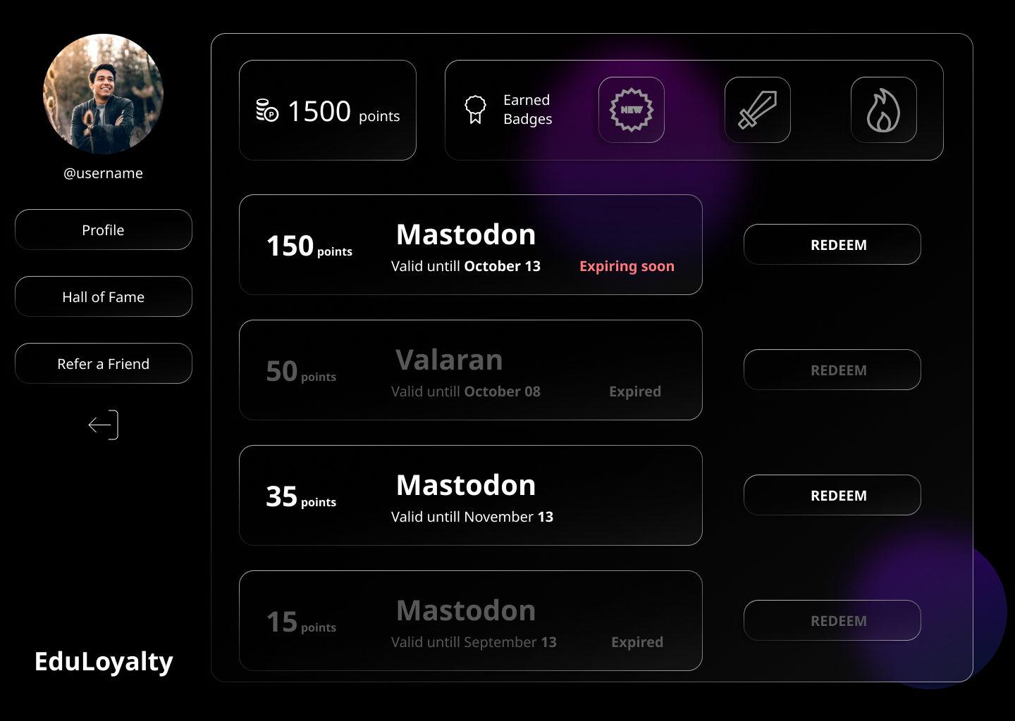
</Requirements
Functional
Sign Up
Dashboard
Points
Coupons
Hall of Fame
Refer a friend
Non-Functional
Security
Interpretability
Responsive
Maintainability
User logs

Slide 4
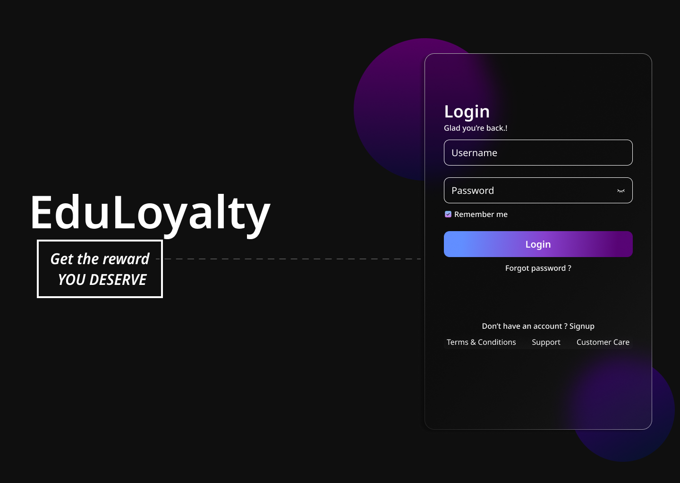

</Requirements
Nice to have
Extension
Purdue Domain

Slide 5



</System Architecture
User Interface
(React)
Middleware
(REST API)
Back End
DB
(MySQL)
Web
Services
Python
Django Framework

Slide 6
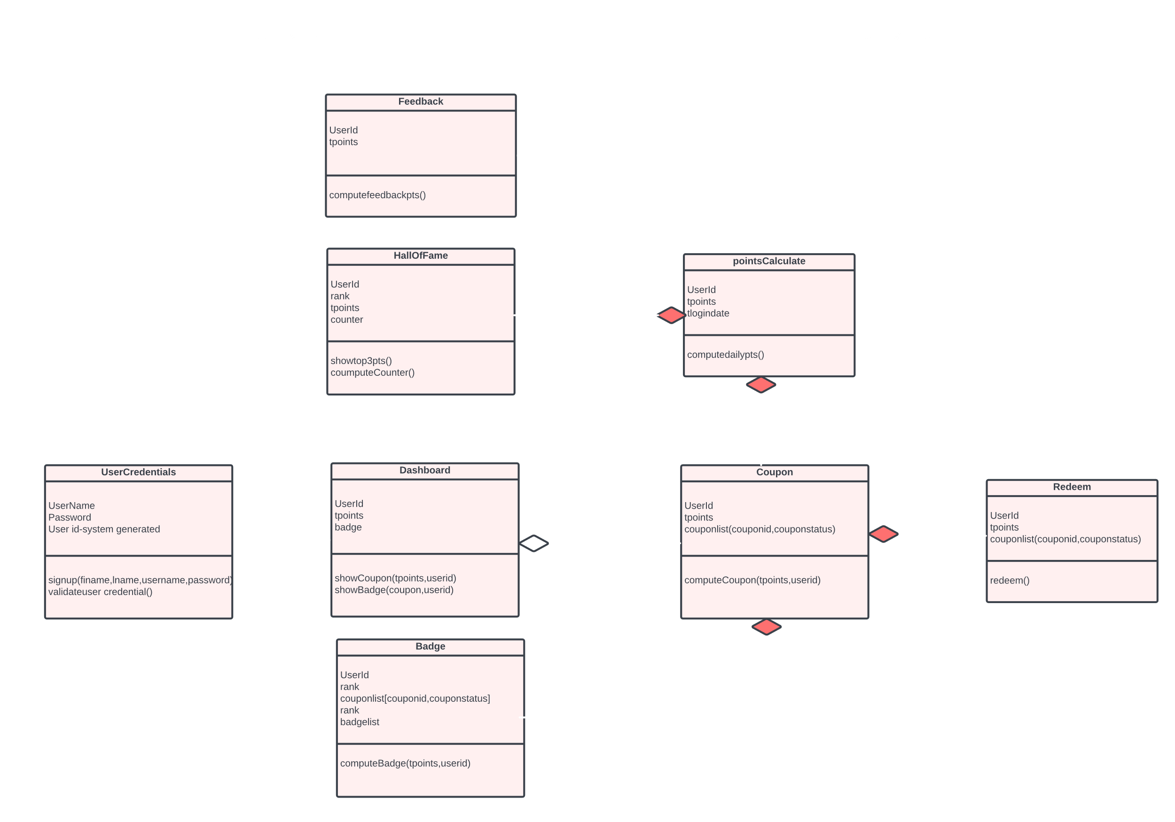
</System Model - Class Diagram

Slide 7

</Thank You

